Slide 1


Basic Python
Tom Zimmerman
IBM Research-Almaden
Center for Cellular Construction
Nov 4, 2021
Based on Python Cheat Sheet https://websitesetup.org/python-cheat-sheet/
This material is based upon work supported by the NSF under Grant No. DBI-1548297.
Disclaimer: Any opinions, findings and conclusions or recommendations expressed in this material are those of the authors and do not necessarily reflect the views of the National Science Foundation.

Slide 2
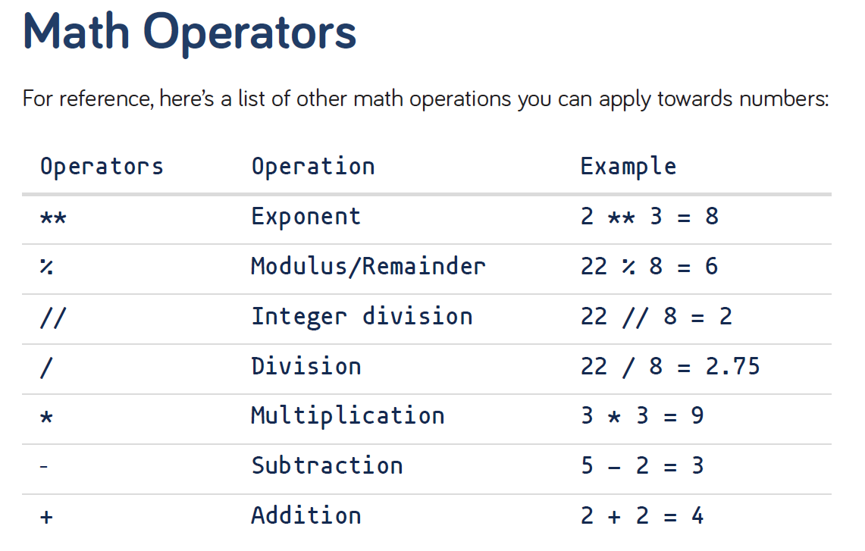
Data Types
Integers -2, -1, 0, 1, 2, 3, 4, 5
Floating-point numbers -1.25, -1.0, --0.5, 0.0, 0.5, 1.0, 1.25
Strings ‘yo’, ‘hey’, ‘Hello!’, ‘what’s up!’
String Concatenation
string_one = “I’m reading “
string_two = “a new great book!”
string_three = string_one + string_two
2+5*2=?
(2+5)*2=?
https://websitesetup.org/python-cheat-sheet/

Slide 3
Input() Function
name = input(“Hi! What’s your name? “)
print(“Nice to meet you “ + name + “!”)
age = input(“How old are you “)
print(“So, you are already “ + str(age) + “ years old, “ + name + “!”
len() Function
str1 = “Hope you are enjoying our tutorial!”
print(“The length of the string is :”, len(str1))
Define a Function
def add_numbers(x, y, z):
a = x + y
b = x + z
c = y + z
print(a, b, c)
return(a+b+c) # return values
sum=add_numbers(1, 2, 3)

Slide 4
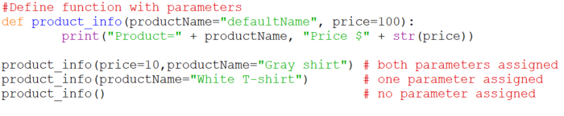
keyword arguments
Lists
my_list = [1, 2, 3] # list of int
my_list2 = [“a”, “b”, “c”] # list of strings
d=1.432
my_list3 = [“4”, d, “book”, 5, 5.234] # list of string, int, float
my_list4 = list((“1”, “2”, “3”))
a = list(('1','2','3'))
a.append(4)
a.insert(2,’foo’)

Slide 5
Homework #1
Write a function with several keyword arguments that returns several values. Show several calls to the function relying on some default keyword values.
Create a list of mixed types (int, float, strings). Print selected items from the list. Append and insert several data types into the list and print out the list.
Give three examples of modulus, division and integer division
Create and concatenate three strings and print the results.
Write a function that asks for a person’s name and returns their name. Run the function and print the result.

